Slide 1
REVIEW NOTES ON ARTIFICIAL NEURAL NETWORK

Slide 2
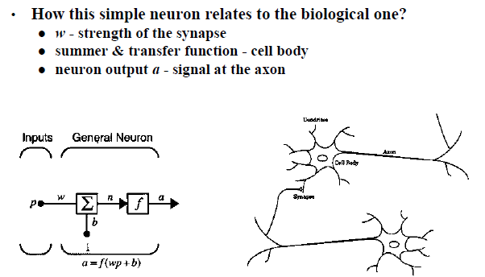
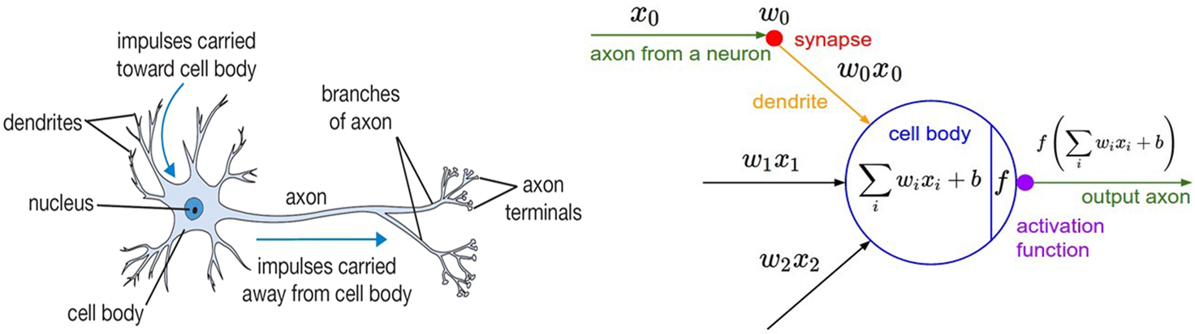
ARTIFICIAL VS BIOLOGICAL NEURON
Notes:
Sources:
https://cs.byu.edu/files/images/neural_networking.jpg

Slide 3
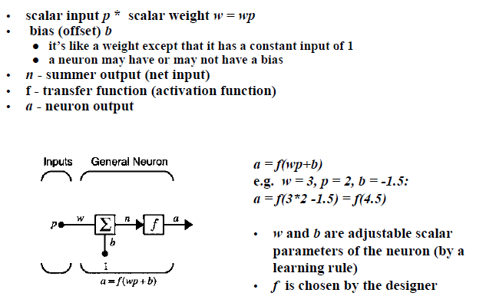
SINGLE-INPUT NEURON

Slide 4
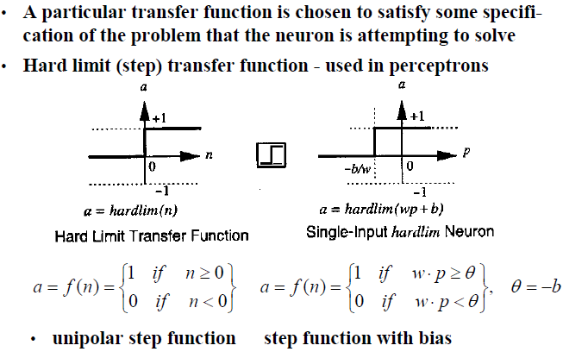
Step Transfer Function

Slide 5
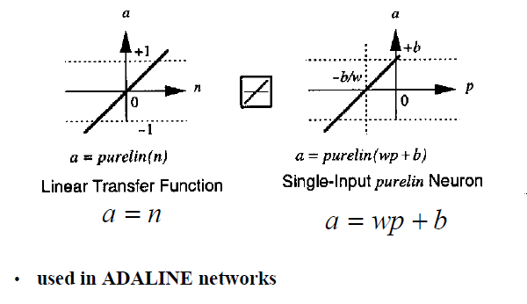
Linear Transfer Function

Slide 6
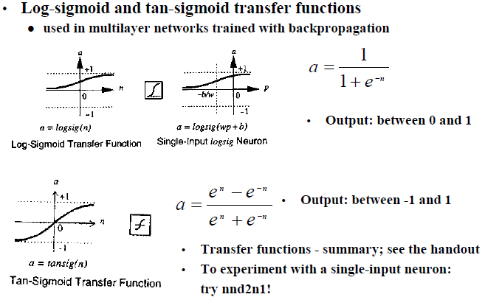
Sigmoid Transfer Function

Slide 7
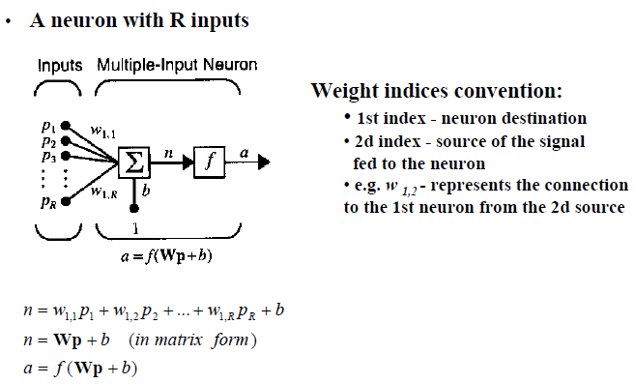
Multiple Input Neuron

Slide 8
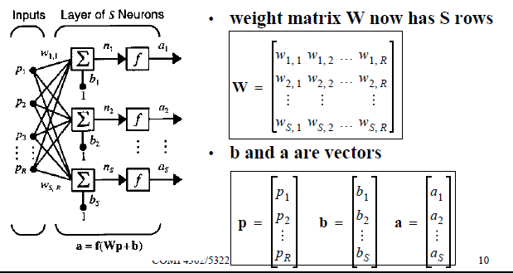
A Layer of Neuron : Network Architectures

Slide 9
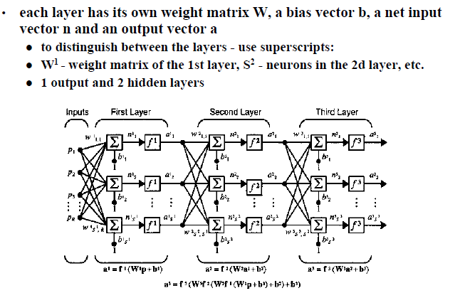
Multilayer Networks

Slide 10
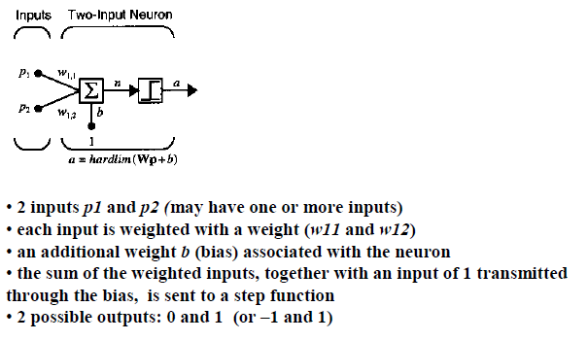
Single-Neuron Perceptron

Slide 11
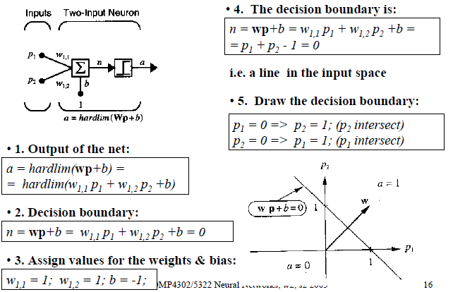
Investigation of the Boundaries

Slide 12
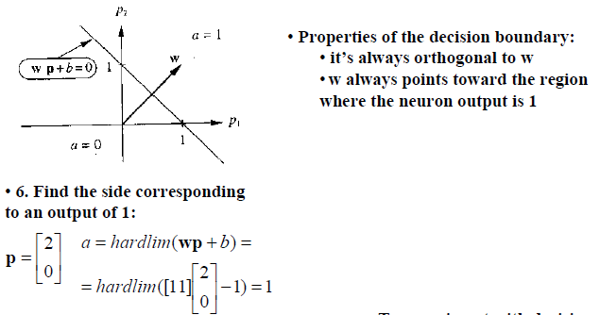
Investigation of the Boundaries

Slide 13
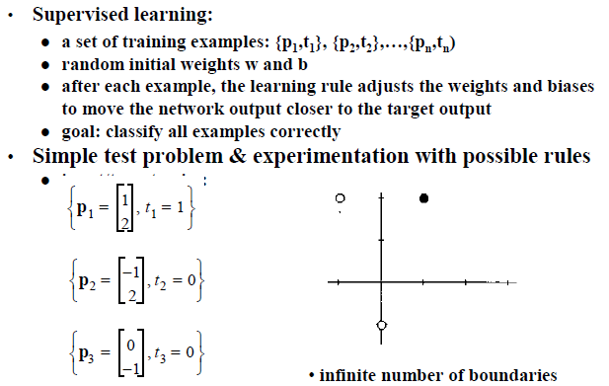
Perceptron Learning Rule - Derivation

Slide 14
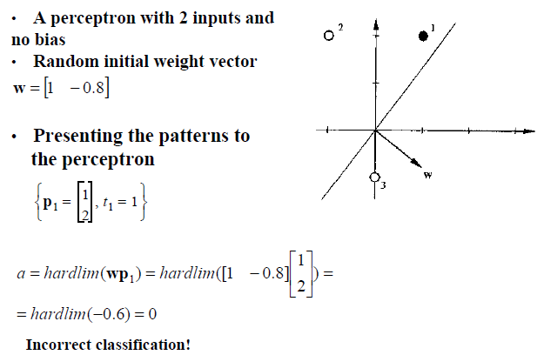
Test Problem – Starting Point

Slide 15
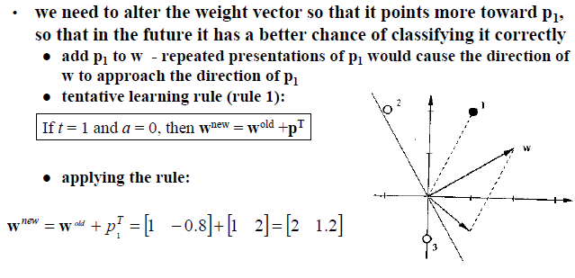
Test Problem – Tentative Learning Rule

Slide 16
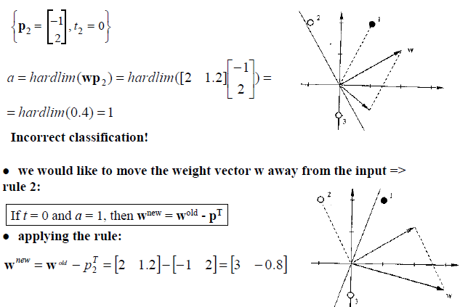
Test Problem – Second Input Vector

Slide 17
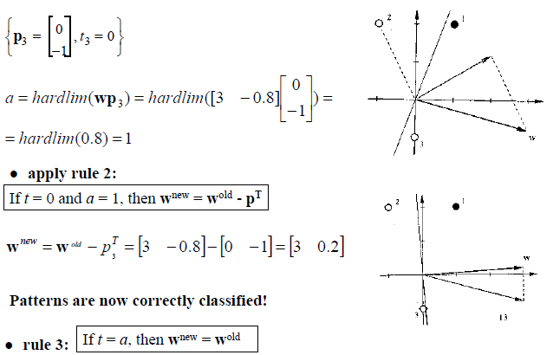
Test Problem – Third Input Vector

Slide 18
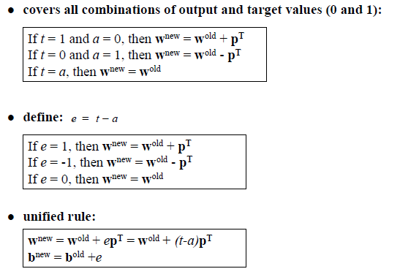
Unified Learning Rule

Slide 19
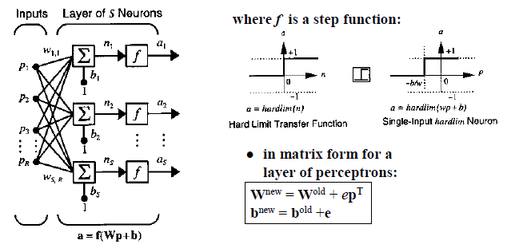
A Layer of Perceptrons

Slide 20
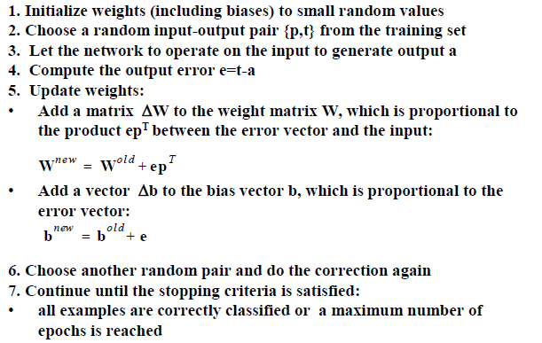
Perceptron Learning Law - Summary

Slide 21
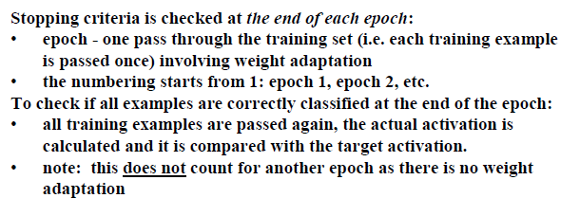
Perceptron – Stopping Criteria

Slide 22
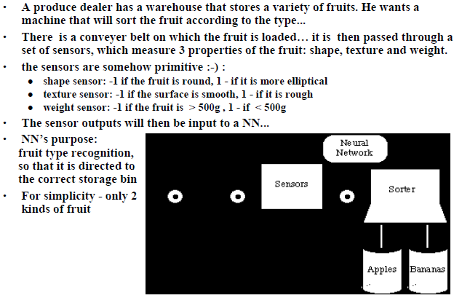
An Example – Apple/Banana Sorter

Slide 23
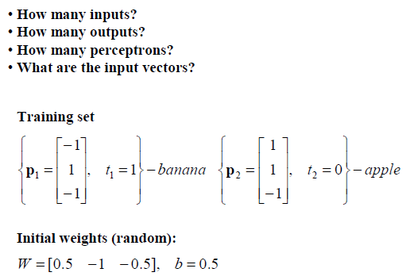
Apple/Banana Example

Slide 24
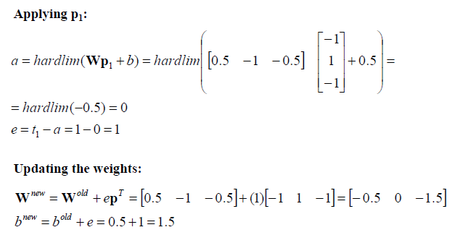
Apple/Banana Example – First Iteration

Slide 25
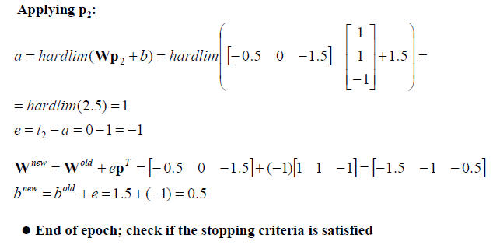
Apple/Banana Example – Second Iteration

Slide 26
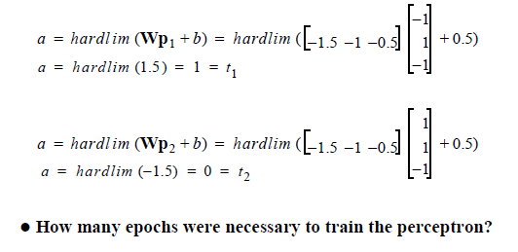
Apple/Banana Example - Check

Slide 27
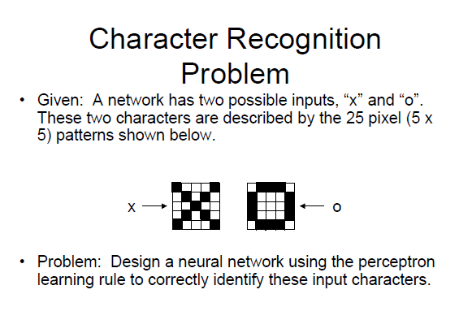

Slide 28
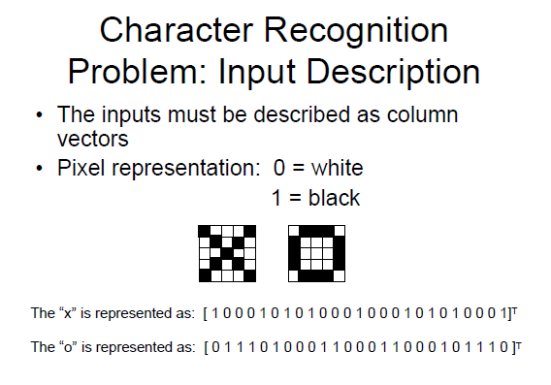

Slide 29
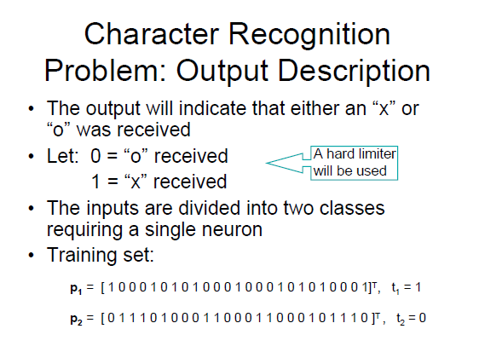

Slide 30
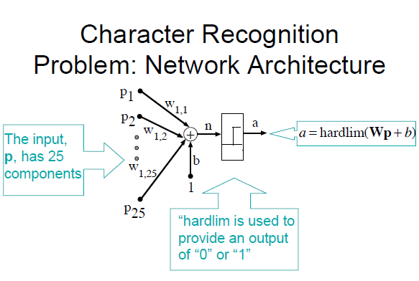

Slide 31
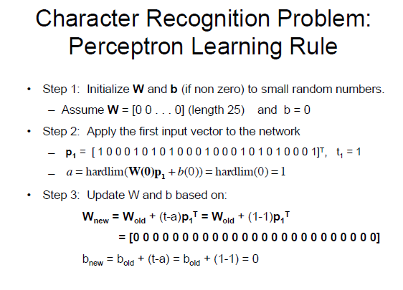

Slide 32
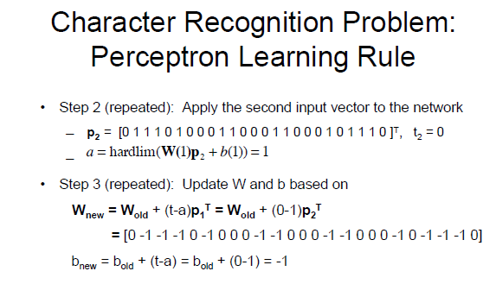

Slide 33
ADALINE Network
ADALINE (Adaptive Linear Neuron) network and its learning rule, LMS (Least Mean Square) algorithm are proposed by Widrow and Marcian Hoff in 1960.
Both ADALINE network and the perceptron suffer from the same inherent limitation: they can only solve linearly separable problems.
The LMS algorithm minimizes mean square error (MSE), and therefore tires to move the decision boundaries as far from the training patterns as possible.

Slide 34
ADALINE Network
Widrow-Hoff learning is an approximate steepest descent algorithm, in which the performance index is mean square error.
It is widely used today in many signal processing applications.
It is precursor to the backpropagation algorithm for multilayer networks.

Slide 35
ADALINE Network
p
S×R
a
W
n = Wp + b
a = purelin(Wp + b)
R×1
n
S×1
+
S×1
1
b
R
S×1
S
S×R
p
a
W
SINGLE-LAYER PERCEPTRON
R×1
n
S×1
+
S×1
1
b
R
S×1
S

Slide 36
Single ADALINE
Σ
Set n = 0, then Wp + b = 0 specifies a decision boundary.
The ADALINE can be used to classify objects into two categories if they are linearly separable.

Slide 37
Adaline Schematic
i₁
i₂
w₀ + w₁i₁ + … + w_{n}i_{n}
Σ
Output
…
i_{n}
Adjust weights
Compare with desired value class(i) (1 or -1)

Slide 38
The Adaline Learning Algorithm
The Adaline uses gradient descent to determine the weight vector that leads to minimal error.
Error is defined as the MSE between the neuron’s net input net_{j} and its desired output t_{j} (= class(i_{j})) across all training samples i_{j}.
The idea is to pick samples in random order and perform (slow) gradient descent in their individual error functions.
This technique allows incremental learning, i.e., refining of the weights as more training samples are added.

Slide 39
The Adaline Learning Algorithm
The Adaline uses gradient descent to determine the weight vector that leads to minimal error.

Slide 40
The Adaline Learning Algorithm
The gradient is then given by
For gradient descent, Δw should be a negative multiple of the gradient:

Slide 41
The Widrow-Hoff Delta Rule
In the original learning rule
Longer input vectors result in greater weight changes, which can cause problems if there are extreme differences in vector length in the training set.
Widrow and Hoff (1960) suggested the following modification of the learning rule:

Slide 43
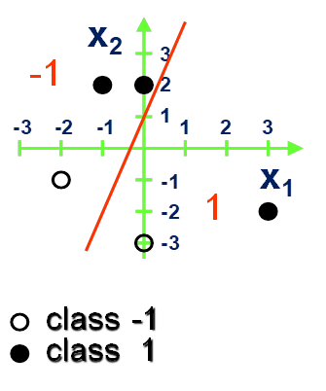
PROBLEM
Latih (train) sebuah single neuron ANN dengan ADALINE yang mampu dengan tepat mengklasifikasikan 5 data set (X, t) sebagaimana terlihat pada gambar di atas. Gunakan LMS Learning Rules dengan bobot awal W11 = 3.0, W12 = 1.0, b = 1.0 dan learning rate α = .05 untuk menghitung nilai bobot W dan bias b berikutnya. Lakukan perhitungan 3 epoch pertama dan berdasarkan hasil proses training tsb, turunkan persamaan garis boundary decision model ADALINE Sdr dan hitung Loss yang Sdr peroleh. Berikan justifikasi Sdr apakah proses training Adaline tsb akan mampu menghasilkan generalisasi yang optimal

Slide 44
Inputs =
[ 1. -1. 2.]
[ 1. 0. 2.]
[ 1. 3. -2.]
[ 1. 0. -3.]
[ 1. -2. -1.]
Initial Weight = [1. 3. 1.]
target: [ 1 1 1 -1 -1] Output: [ 0. 3. 8. -2. -6.] Error: [ 1. -2. -7. 1. 5.]
Bias: 0.9 W1: 1.4 W2: 1.2
SSE : 40.0
Cost: [40.0]
target: [ 1 1 1 -1 -1] Output: [ 1.9 3.3 2.7 -2.7 -3.1] Error: [-0.9 -2.3 -1.7 1.7 2.1]
Bias: 0.845 W1: 0.98 W2: 0.69
SSE : 8.145
Cost: [40.0, 8.145]
target: [ 1 1 1 -1 -1] Output: [ 1.245 2.225 2.405 -1.225 -1.805] Error: [-0.245 -1.225 -1.405 0.225 0.805]
Bias: 0.75275 W1: 0.701 W2: 0.6095
SSE : 2.117
Cost: [40.0, 8.145, 2.117]
Weight: [wo, w1, w2] : [0.75275 0.701 0.6095 ]
a: -1.1501230516817063 b: -1.2350287120590648 (PARAMETER DECISION LINE)
EPOCH 1
EPOCH 2
EPOCH 3

Slide 45
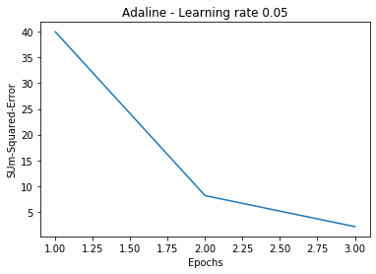
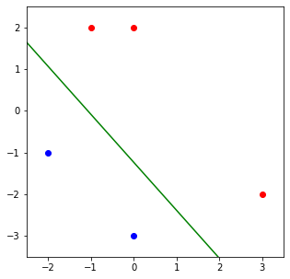


Slide 46
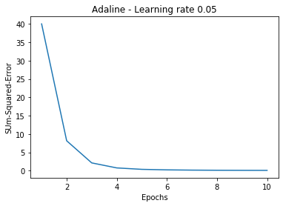
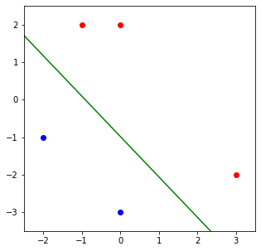

Slide 47
Backpropagation learning algorithm ‘BP’
Solution to credit assignment problem in MLP. Rumelhart, Hinton and Williams (1986) (though actually invented earlier in a PhD thesis relating to economics)
BP has two phases:
Forward pass phase: computes ‘functional signal’, feed forward
propagation of input pattern signals through network
Backward pass phase: computes ‘error signal’, propagates
the error backwards through network starting at output units
(where the error is the difference between actual and desired
output values)

Slide 48
Conceptually: Forward Activity - Backward Error

Slide 49
Forward Propagation of Activity
Step 1: Initialize weights at random, choose a learning rate η
Until network is trained:
For each training example i.e. input pattern and target output(s):
Step 2: Do forward pass through net (with fixed weights) to produce output(s)
i.e., in Forward Direction, layer by layer:
Inputs applied
Multiplied by weights
Summed
‘Squashed’ by sigmoid activation function
Output passed to each neuron in next layer
Repeat above until network output(s) produced

Slide 50
Step 3. Back-propagation of error

Slide 51
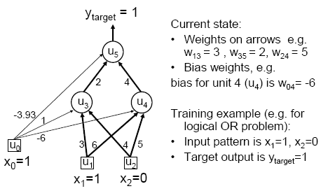
MLP/BP: A worked example

Slide 52
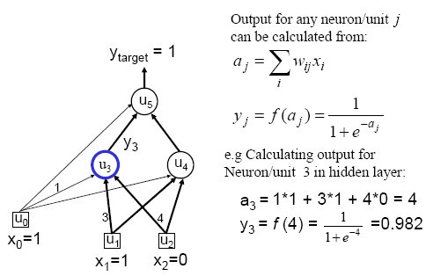
Worked example: Forward Pass

Slide 53
Worked example: Forward Pass

Slide 54
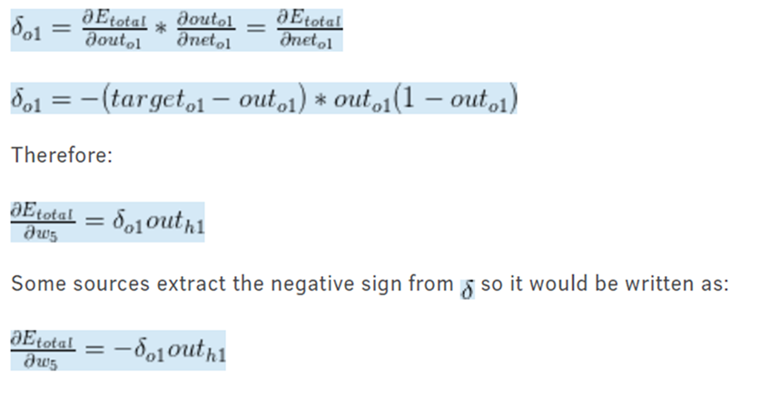
Worked example: Backward Pass

Slide 55
Worked example: Update Weights Using Generalized Delta Rule (BP)

Slide 56
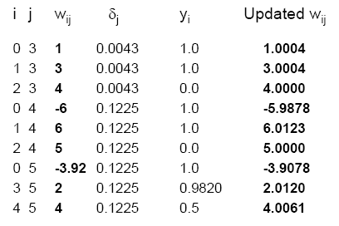
Similarly for the all weights wij:

Slide 57
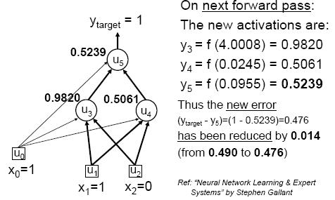
Verification that it works

Slide 58
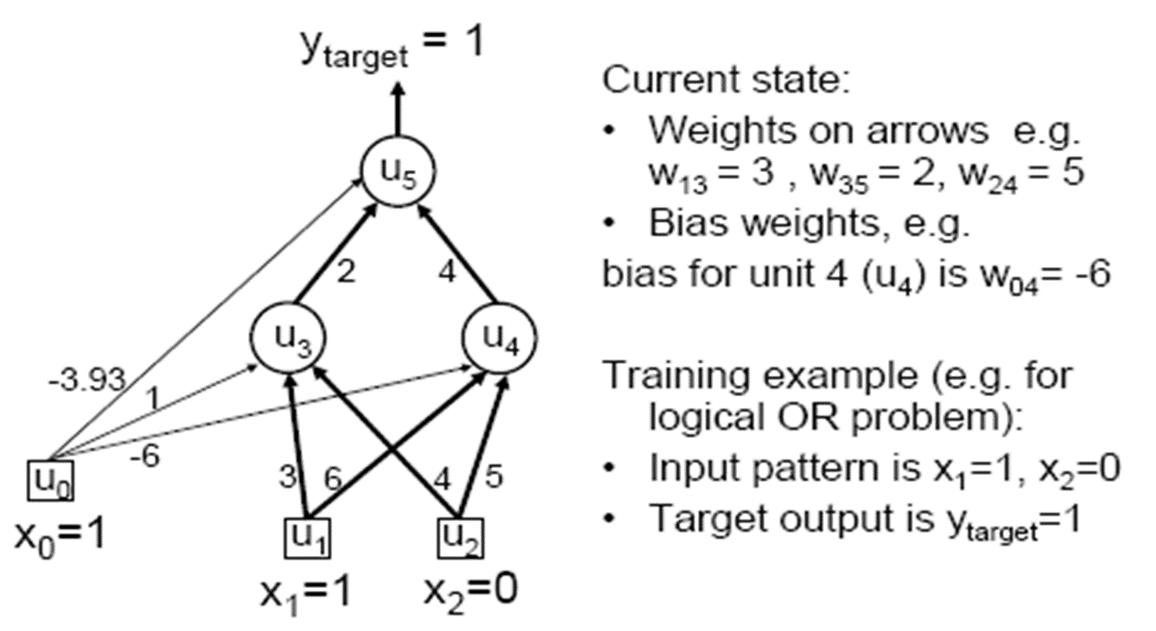
Initial hidden weights: [3. 6.] [4. 5.]
Initial hidden biases: [ 1. -6.]
Initial output weights: [2.] [4.]
Initial output biases: [-3.93]
Final hidden weights: [3.92794571 9.8071798 ] [3.9279819 9.80020041]
Final hidden bias: [-5.87200846 -2.43171093]
Final output weights: [-8.40883702] [8.42301753]
Final output bias: [-4.10619277]
Output from neural network after 100,000 epochs: [0.03078948] [0.96298378] [0.96298127] [0.0441378]

Slide 59
ASSIGNMENT: BACKPROPAGATION NEURAL NETWORKS
The following figure shows an ANN consisting of 2 input (u1, u2) and bias (u0), 1 hidden layer with 2 neuron (u3, u4), and 1 output neuron (u5) respectively. Let the activation function employed for each neuron (u3, u4, and u5) is sigmoid function. If the ANN is designed to tackle Logical XOR problem, update W_{ij} after 1 (ONE) EPOCH ONLY using backpropagation algorithm with learning rate η = 0.1. Please also check if the error is reduced.
Training example (e.g.for logical XOR problem

Slide 60
XOR-BPNN SOLUTION
FROM HIDDEN TO OUPUT :
[[-2.45799235 0.03402758 -0.86762002 2.0425579 ]]
OUTPUT : 1/(1+e^{-net})
[[0.07885605 0.50850607 0.29574977 0.88519347]]
ERRORS : 1.58265
[[-0.07885605 0.49149393 0.70425023 -0.88519347]]
WEIGHTS-TO-HIDDEN :
[[ 1. 3. 4.]
[-6. 6. 5.]]
BIAS + INPUTS :
[[1. 1. 1. 1.] BIAS
[0. 1. 0. 1.]
[0. 0. 1. 1.]]
NET INPUT TO HIDDEN :
[[ 1. 4. 5. 8.]
[-6. 0. -1. 5.]]
HIDDEN OUTPUT : 1/(1+e^{-net})
[[0.73105858 0.98201379 0.99330715 0.99966465]
[0.00247262 0.5 0.26894142 0.99330715]]
WEIGHT-TO-OUTPUT :
[[-3.93 2. 4. ]]

Slide 61
Output (δ5) : y5(1-y5) * (target-y5)
[[-0.00572793]
[ 0.12283792]
[ 0.14668254]
[-0.08995866]]
Error_Hidden : w35* δ5 and w45 * δ5
[[-0.01145585 -0.02291171]
[ 0.24567584 0.49135168]
[ 0.29336507 0.58673014]
[-0.17991732 -0.35983465]]
hiddenLayer_Delta (δ3 & δ4): y3(1-y3)*w35* δ5
[[-2.25235769e-03 -5.65119428e-05]
[ 4.33930019e-03 1.22837920e-01]
[ 1.95030763e-03 1.15358148e-01]
[-6.03150644e-05 -2.39220112e-03]]
Delta_output_weight = η * δ5 * Hidden_Output
[[0.01722134] → W₅₃ = 2.0 + 0.01722
[0.00114972]] → W₅₄ = 4.0 + 0.00115
Delta_hidden_weight = η ∗ δ3 * input and η ∗ δ4 * input
[[0.0004279 0.01204457]
[0.000189 0.01129659]]
W₃₁ = 3.0 + 0.00043
W₃₂ = 4.0 + 0.00019
W₄₁ = 6.0 + 0.01204
W₄₂ = 5.0 + 0.01129
Output 2nd epoch :
[[0.0810904 ]
[0.52611437]
[0.30892259]
[0.88889655]]
New error : ∑ e² = 1.49884
[[-0.0810904 ] [ 0.47388563] [ 0.69107741] [-0.88889655]]
PREVIOUS ERRORS : 1.58265
[[-0.07885605 0.49149393 0.70425023 -.88519347]]

